Slide 1
MSCDA5520​
Statistical Business
Analytics ​
TEAM 1
Case 2 – Elite Cars
Aman Sharma
Bhavya Ahuja​
Maninder Kaur​
Santhamohan Manivannan​
Simon Achkar​
Zewei Yan​

Slide 2
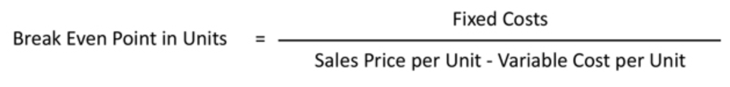
Break-Even Analysis
The break-even analysis lets us determine how many days we need to rent the cars, monthly, to cover our costs of doing business—our break-even point.

Slide 3
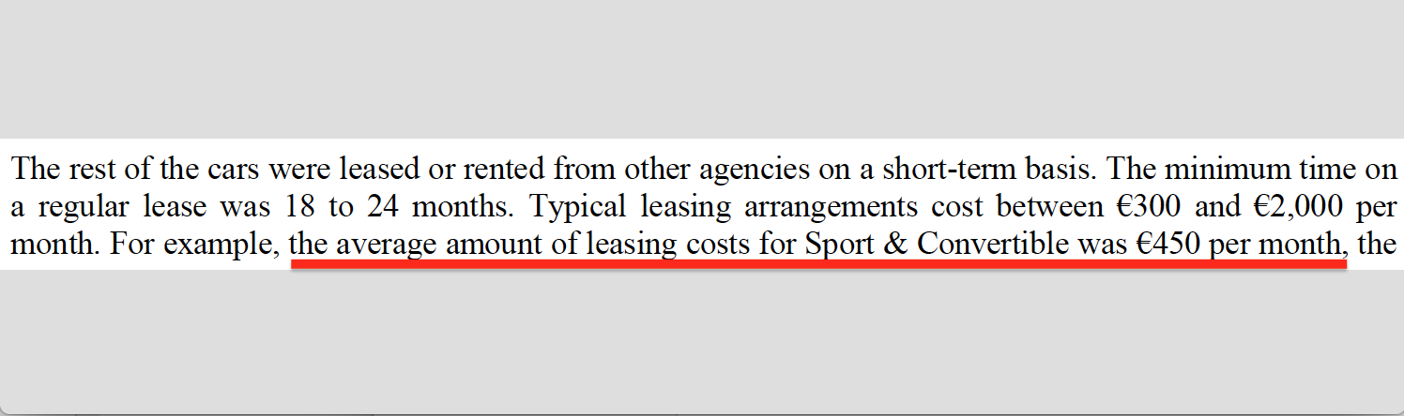
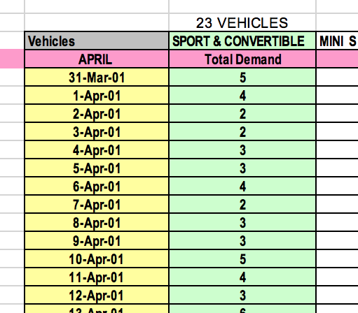
Long-term Leased Sport & Convertible Cars
Monthly Fixed Cost
450 € / month per car
23 vehicles (ref: 7B07E011A)
150 € insurance / month on average
Fixed Cost = 450 * 23 + 150
Revenue per day
Daily Rate: 400 € / day per car
Average rented car: 8.367 (mean of the data from
7B07E011A)
Revenue per day = 400 * 8.367
Variable Cost per day
Maintenance Costs: 30 € / month per car
Average rented car: 8.367
A month is 30 days
Maintenance Costs per day: 1 € per car
Variable Cost per day = 8.367

Slide 4
Purchased Sport & Convertible Cars
Monthly Fixed Cost
Avg Car Cost: 40 000 €
Amortization (2%): 800 € / month per car
23 vehicles (ref: 7B07E011A)
150 € insurance / month on average
Fixed Cost = 800 * 23 + 150
Short-Term Leased Sport & Convertible Cars
Monthly Fixed Cost
1000 € / month per car
23 vehicles (ref: 7B07E011A)
150 € insurance / month on average
Fixed Cost = 1000 * 23 + 150

Slide 5
Calculations

Slide 6
Recommended Lot
Optimal number of Cars needed to the run the company
We should not Understock the car (Wasting the Opportunity of Profit)
We should not Overstock the car (Making the Loss )
We made two approaches to make the recommendation
Histogram
Calculation

Slide 7
Calculations Sports & Convertibles
Fixed Cost per month(Leasing the whole fleet)
10350(450*23)
Renting the Car per month(Renting for whole month)
12000(400*30)
Profit->1650
Loss->Fixed Cost(If no one rents the car)->10350
Probability ->.86
Z->1.09
Mean->8.37
SD->4.7
Optimal Number of Cars we need->14

Slide 8
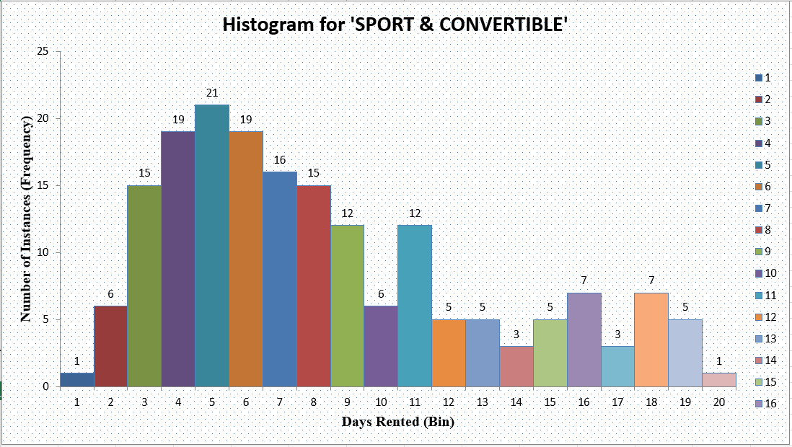
Histogram (Density and the Frequency)

Slide 9
Calculations 4Wheels Drive
Fixed Cost per month(Leasing the whole fleet)
2400(600*4)
Renting the Car per month(Renting for whole month)
16500(550*30)
Profit->14100
Loss->Fixed Cost(If no one rents the car)->2400
Probability ->.145
Z->-1.06
Mean->1.55
SD->1.08
Optimal Number of Cars we need->1

Slide 10
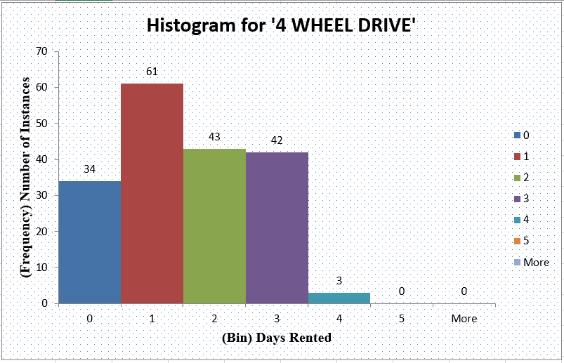
Histogram (Density and the Frequency)

Slide 11
How should we divide the fleet
Optimal Number of cars
Total number of cars in the fleet
Duration of Lease (if leased)
Costs of the cars (if purchased)
Insurance Costs
Budget for purchasing (2 millions)

Slide 12
Leasing vs. Purchasing
Purchasing: we will make a profit when selling the car, so it is always better to purchase. BUT we should not purchase a large number of cars because we would not be able to return it costs from lending them.
Amortization will make the profit lower after 18 months (when we sell the car)
It is best to buy X number of cars where X is the optimal number calculated previously
For example we have 23 sports and convertible cars, we should buy only 14 which is the optimal number of cars. And lease the rest (9 cars)

Slide 13
Short term vs. Long term Leasing
If we lease for long-term, we are getting the cars for two summer seasons (18 months or 24 months)
If we lease for short-term, we are paying more and we are only using the cars for one season (9 months)
SO it is better to lease for long term.

Slide 14
Category | Purchasing | Long Term Leasing
Sports and Convertibles | 14 | 9
4 Wheelers | 1 | 3
Exceptional | 0 | 3

